Slide 1

Anti-Sway Control of Overhead Cranes
Reinaldo Maslim
Supervisor: Dr. Chen Silu

Slide 2
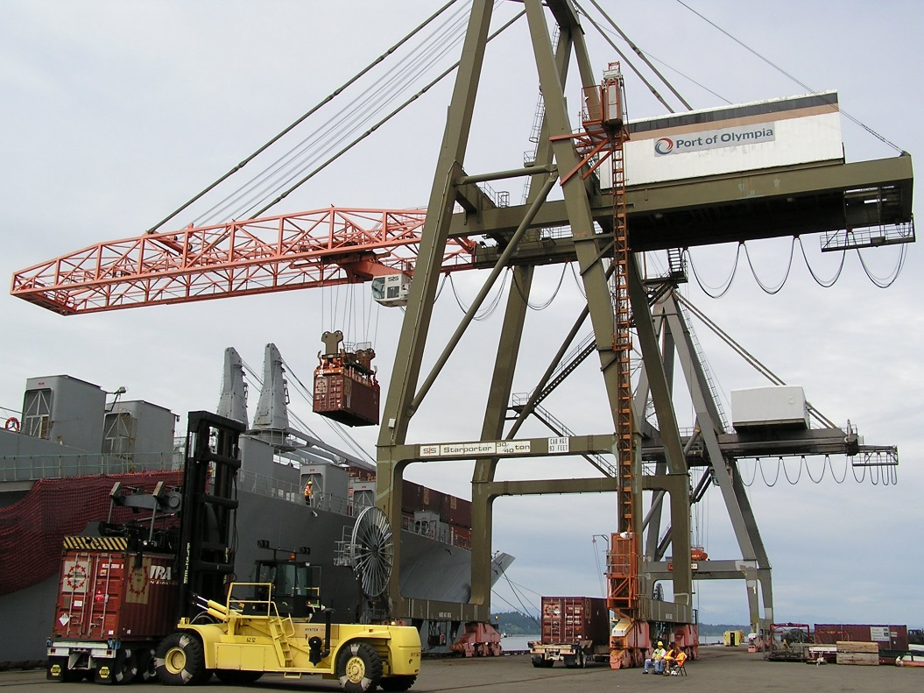
About gantry cranes
Used in several industries: ports, steel mills, nuclear power plant, etc.
Can deliver any bulky loads
Controlled manually by operator
Swaying of load decreases productivity, safety, and requires very skillful operator
Swaying motion caused by:
Acceleration
External disturbance: wind

Slide 3
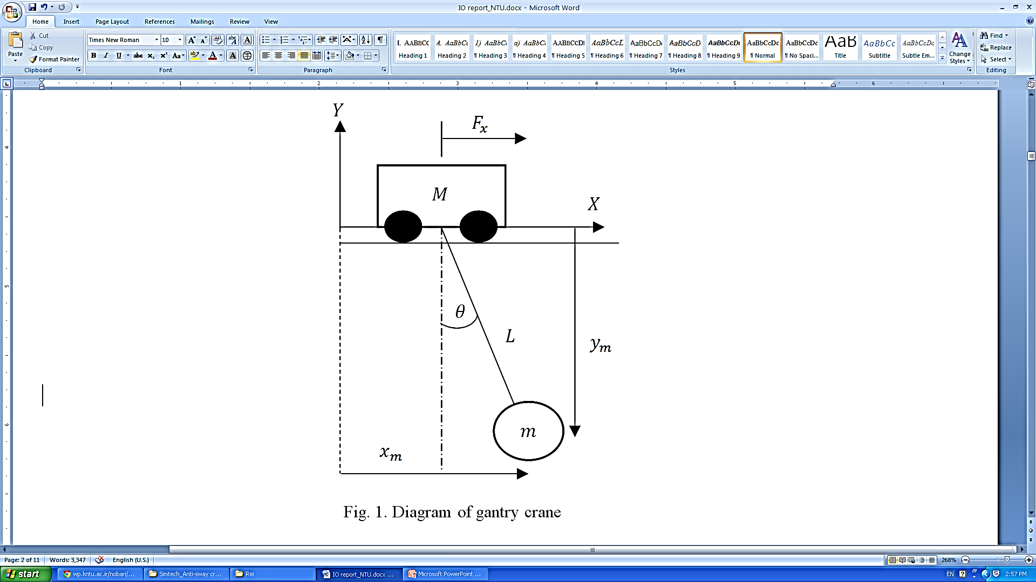
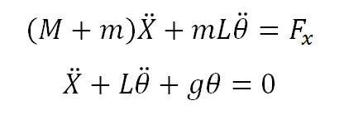
System to be Controlled
Assumptions:
The trolley and payload are regarded as point masses.
Friction force can be neglected.
The length of hoisting rope is time-invariant.
The trolley and load move in a 2D plane.
Practically, the sway angle is small.
Langrangian mechanics

Slide 4
Control strategies
Time Optimal Control
Feedback Control
Input Shaping (Feedforward)
Bang-Bang
Linear Quadratic Regulator
PID
Precalculated trajectory
Zero Vibration-filter
Gain Scheduling
Genetic algorithm
Fuzzy logic
Artifical Neural Network
Sliding Mode

Slide 5
Control Strategies
OPEN-loop INput Shaping Method
Adapted from observation of operators:
Accelerate → Sway minimum
Constant velocity → Sway maximum
Accelerate → Speed trolley=speed payload
Repeat to achieve max speed
Reverse maneuver to stop

Slide 6
Control Strategies
Area under velocity graph= travelled distance. Acceleration profiles can be precalculated.
For optimum time transfer, use maximum acceleration pulses.
Mathematical proof in report.

Slide 7
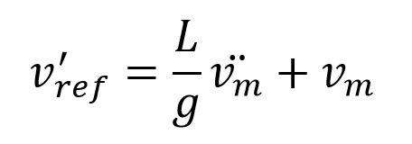
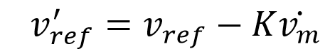
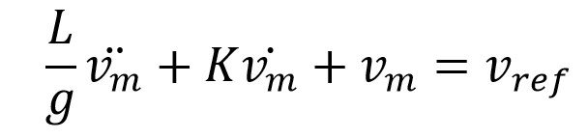
Control Strategies
CLOSED-LOOp anti-sway damping factor with sway-angle estimator
Second order without damping:
Modified equation includes damping
for Anti-sway mechanism

Slide 8
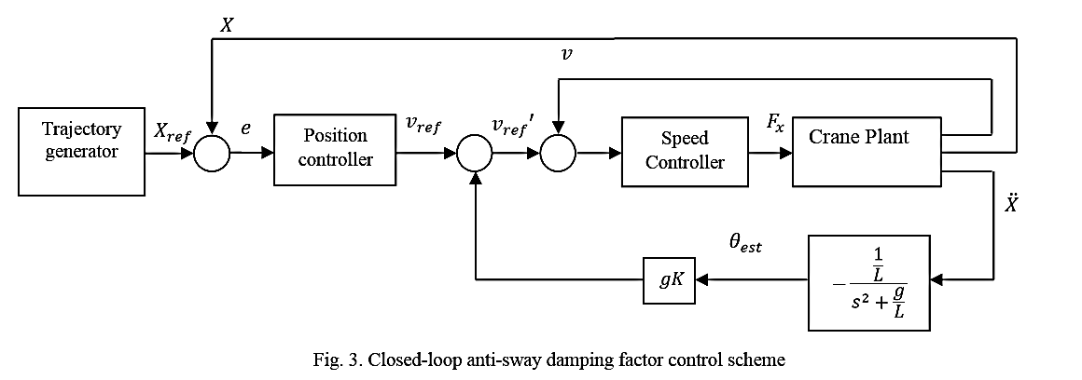
Control Strategies; Adding sway angle feedback term
Conventional PD control in Position and Speed controllers.
K value can be tuned for preferable performance (damping coefficient)

Slide 9
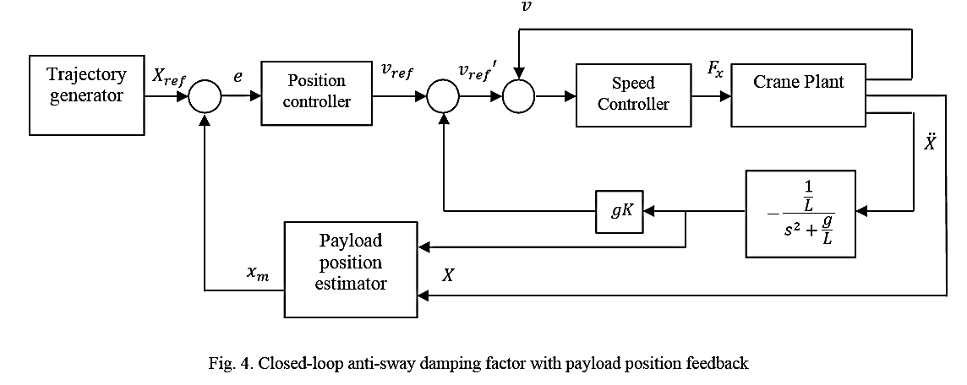
Control Strategies; using payload position instead of trolley position
CLOSED-LOOp with payload position As feedback

Slide 10
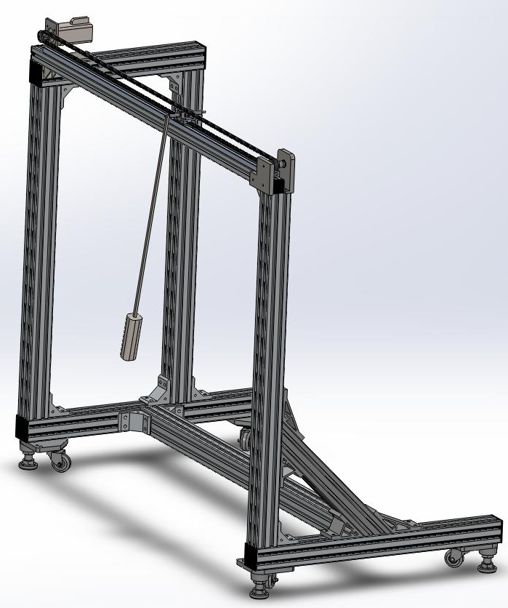
Testbed Model Design
TABLE 1
Parameters | Actual Crane | Model Crane
Trolley mass M | 26 ton | 1.2 kg
Payload mass m | 67.3 ton | 1 kg
Length of hoist rope L | 40 m | 0.6 m
Rated speed of trolley | 3 m/s | 0.5 m/s
Rated acceleration time | 0.5 m/s² | 0.1 m/s²
Rated power of trolley motor | 110 kW | 232 W
Gravitational acceleration g | 9.81 m/s² | 9.81 m/s²

Slide 11
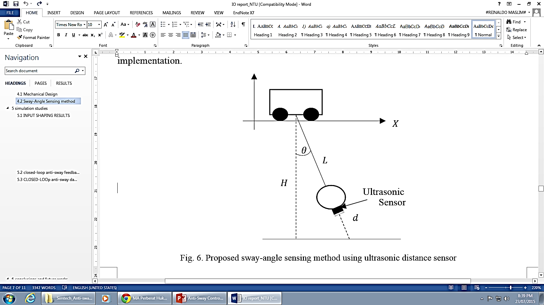
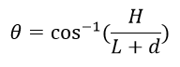
Sway-angle Sensing Verification
Angle verification difficult in testbed because string is used instead of rod.
High resolution sensor 1mm with sufficient feedback frequency.
Sway angle can be obtained as

Slide 12
Simulation Studies
A delivery task is assigned to all three control schemes.
Transfer load from 0 m to 120 m with average velocity of 3m/s. Parameters used shown in Table 1.

Slide 13
Simulation Studies; Results of Input shaping
Good performance in indoor environment where no disturbance exist.
Cannot work well when disturbance exist because no feedback.
Suitable for Indoor cranes.

Slide 14
Simulation Studies; Results of Antisway feedback term
Settling time can be decreased at the cost of higher overshoot.
Able to suppress sway angle even at the presence of wind.

Slide 15
Simulation Studies; Results of Payload position feedback
Payload’s position tracking to generated trajectory can be guaranteed -> Safety is ensured even in wind’s presence.
Trolley keeps swaying to and fro to compensate for trolleys swaying due to wind or acceleration-induced motion.

Slide 16
Simulation Studies
Concern:
Velocity of trolley must be set within feasible range of real motors→ slower trajectory→less favourable.

Slide 17
Conclusions
All three controllers are able to work with each of their advantages and disadvantages.
A testbed has been developed for further studies.

Slide 18
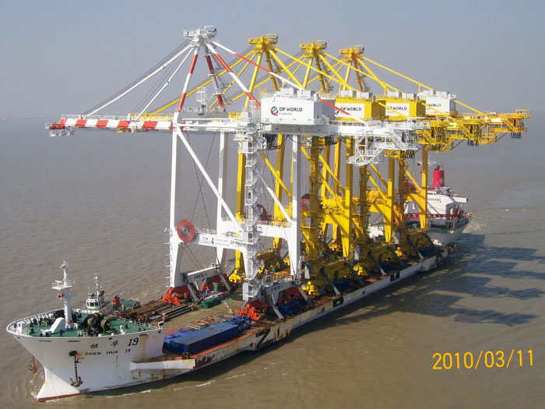
Future Works
Include more varying parameters.
Mathematically proof control strategy and stability of closed loop with payload’s position feedback controller.
State observers implemented for real time.
Model-free controllers must be developed.
Integration with Active Heave Compensation(AHC) for offshore cranes.

Slide 19
Thank you for your attention ☺
We welcome your questions, suggestions or comments!

